Slide 1
Sales Dashboard_zeaves
File created on: 3/6/2023 9:38:47 PM

Slide 2
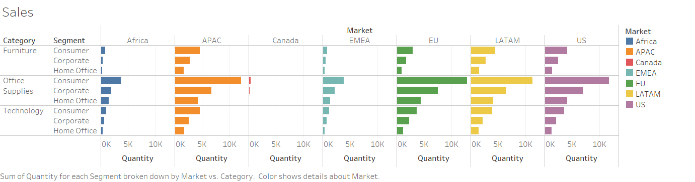

Slide 3
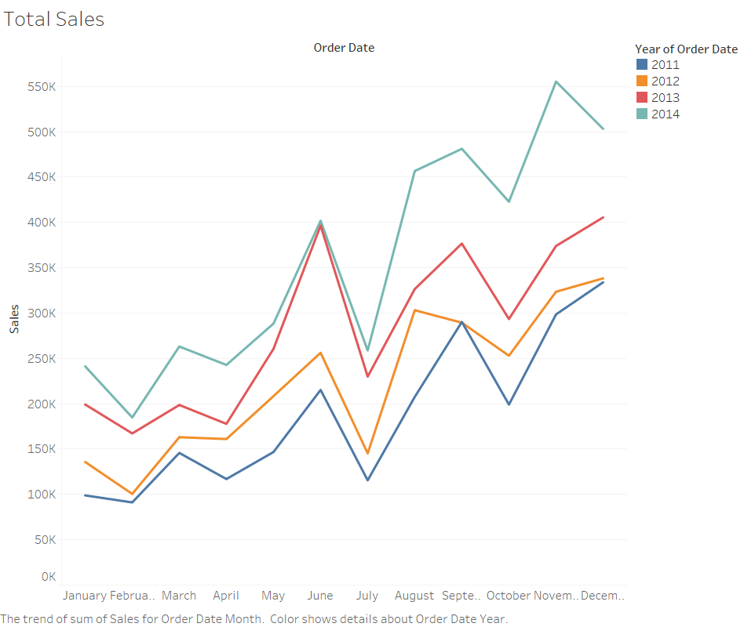

Slide 4
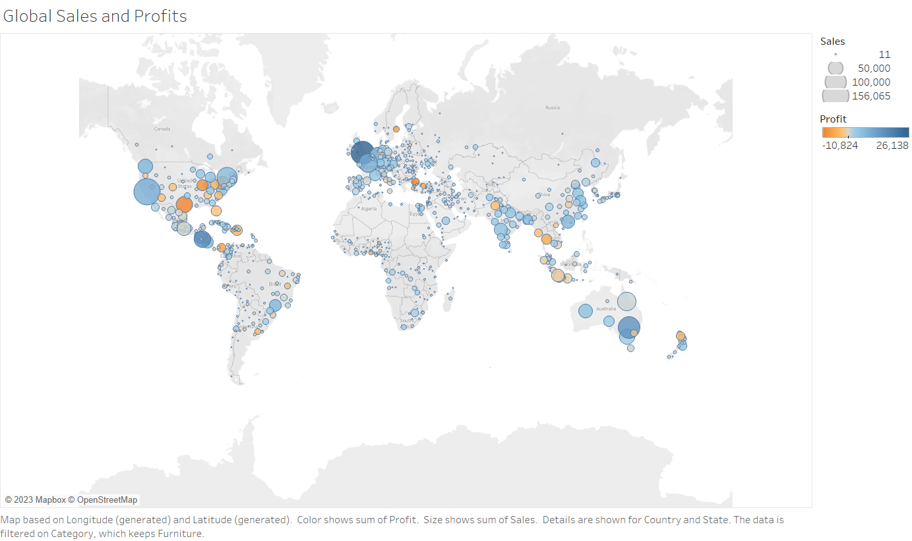

Slide 5
